Slide 1
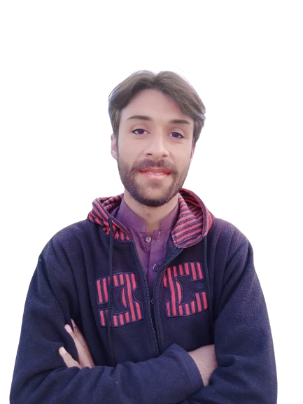
Complex Task Series
Problem Number 96

Slide 2
Problem Statement
Write A Desktop Application In Python To Get A String From User To Convert Into Lowercase, If Already String In Lower Case Then Display A Message, “String Is Already In Lowercase”

Slide 3
Algorithm
Step1: Create A Basic Window
Step2: Set Geometry For That Window
Step3: Get A String From User
Step4: Convert String To Lowercase If Not.
Step5: If String Is In Lowercase, Display A Message “String Is Already In Lowercase”
Step6: Display The Result To User
END

Slide 4
Assignment
Write A Web Application In Python To Get A String From User To Convert Into Uppercase, If Already String In Uppercase Then Display A Message, “String Is Already In Uppercase”

